Slide 1
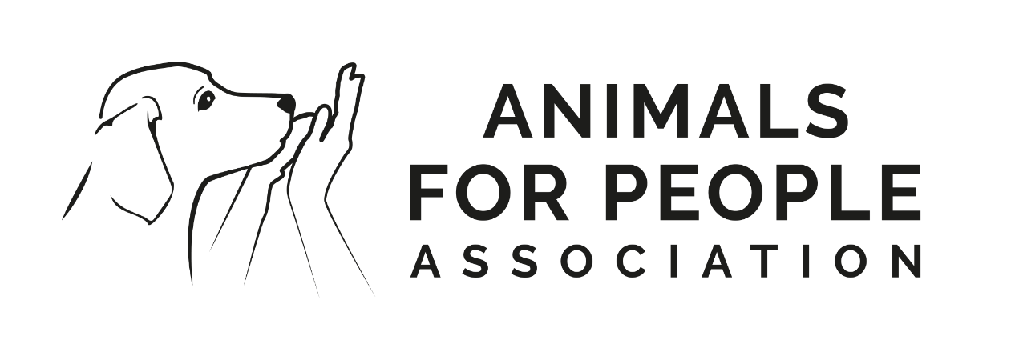
Dog in AAI
Training, chalenges and opportunities
Magdalena Nawarecka-Piątek

Slide 3
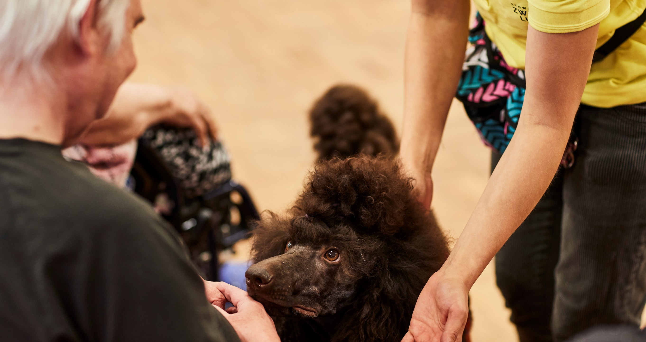
Dog-client focus
Calmness in the dog
Handler suport
Client happiness

Slide 4
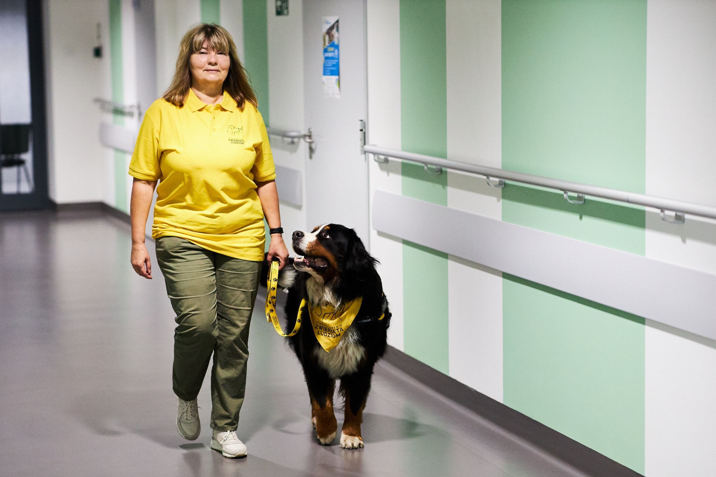
It is the handler's responsibility to:
Prepare the right scenario (both for the dog and the client)
Prepare the dog for the scenario
Work with the dog properly
Avoid unwanted situations

Slide 5
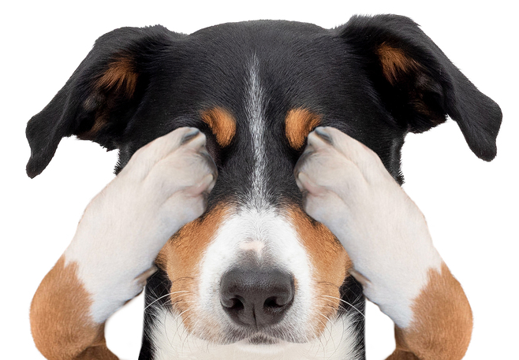
Situations that need to be avoided

Slide 6
Pulling on leash
Why?
It may scare patients
It might be dangerous for the dog
It makes walking in crowded area more complicated
It does not look nice and polite
How to avoid?
Train on walking on the leash
Remember about helping your dog to calm down before you enter
Use clear commands and body language
Take your time (arrive several minutes ealier)

Slide 7
Dog jumps and/or licks patients
Why
It may be dangerous for the patient
It may be dangerous for the dog
It may be unhelthy both for the dog and patient
Patient may be scared
How to avoid?
Train on greeting patients nicely
Make a routine with the situation
Remember about helping your dog to calm down before he says hello
Use clear commands and body language

Slide 8
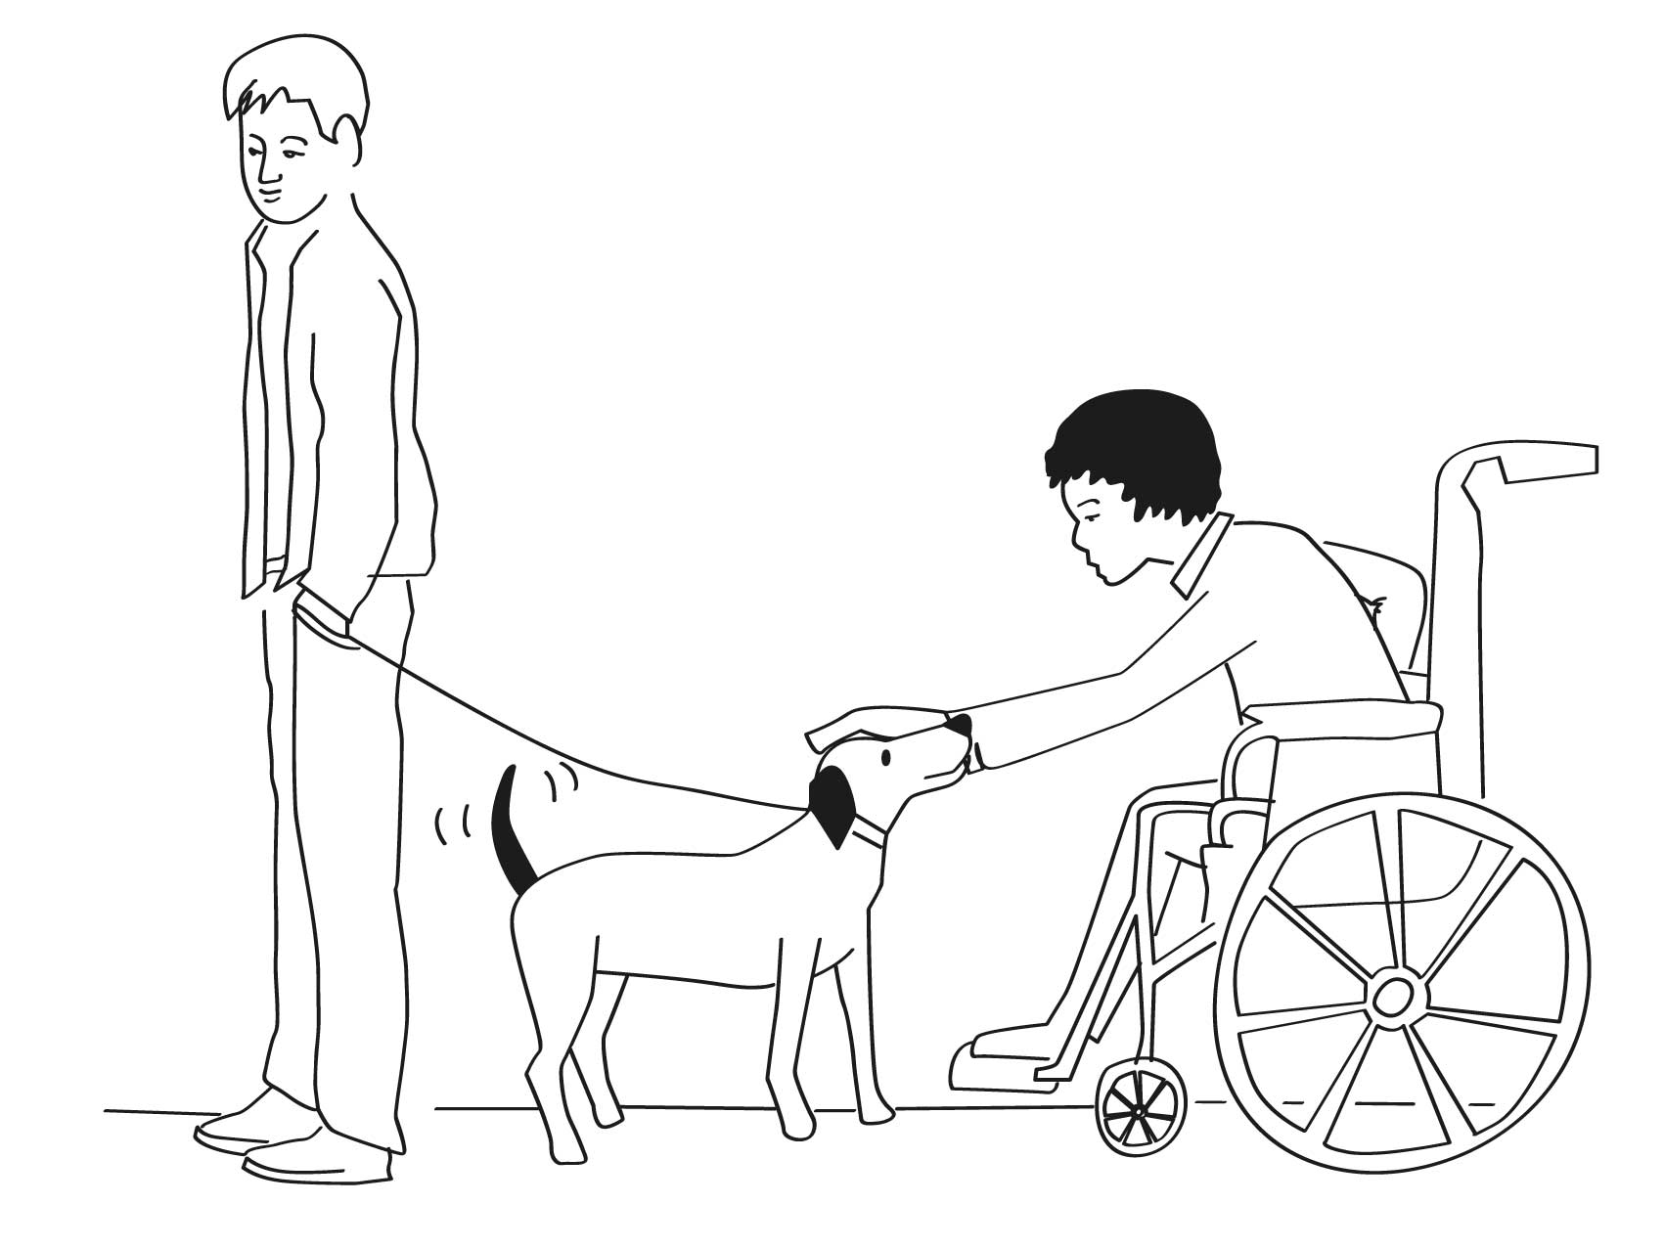
Lack of suport for the dog in tought situations
Why?
It might be dangerous for the dog
It forces your dog to take the responcibility
Intervention is a temat work!
It is stressfull for the dog
How to avoid?
Focus on here and now
Always think about your dog
Try to predict patients behaviours
Watch the enviroment carefully

Slide 9
The dog ignores tha patient’s comand
Why?
It may increase lack of self-confidence
It may lower the motivation
It may cause sadness in the patient
There is lack of interaction
How to avoid?
Train with diffrent people
Build high expectations for people in the dog
Use your body language to help the dog
train train train ☺ lifelong learning

Slide 10
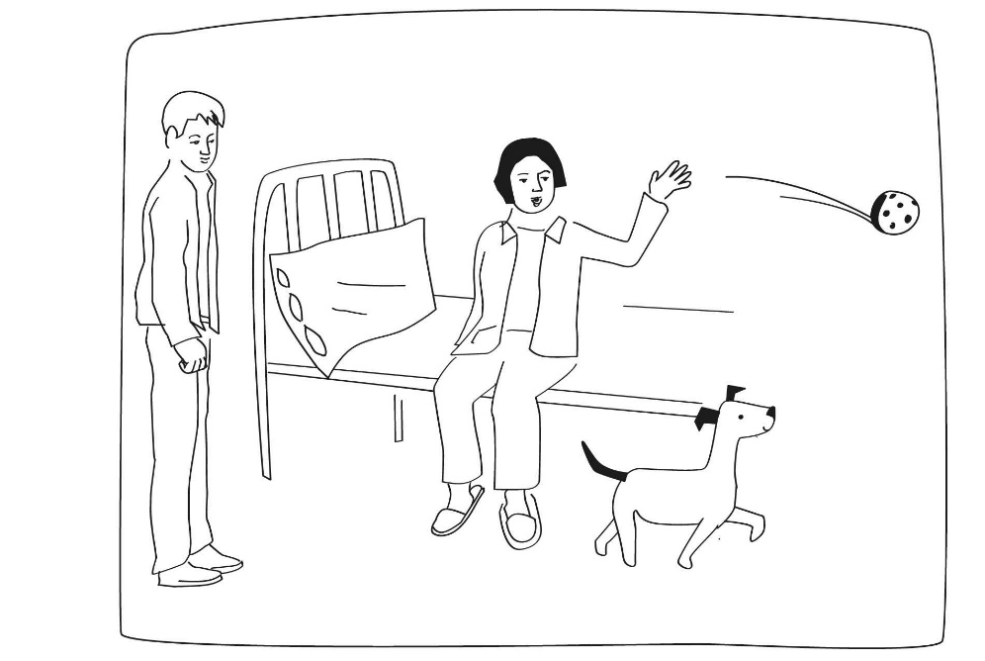
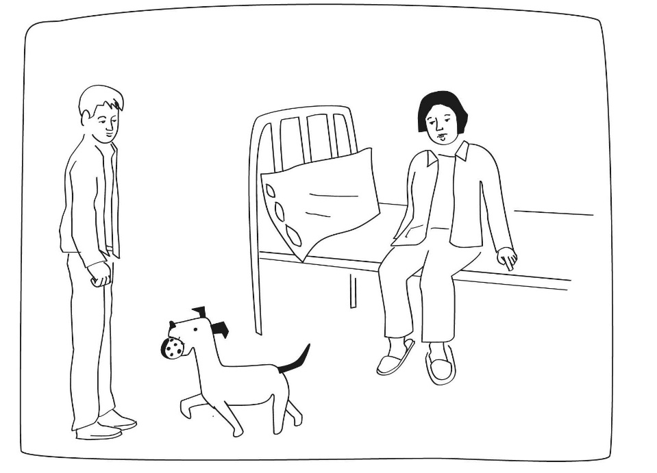
The dog does not want to play with the patient
Why?
It may increase sadness
You can not „use” the dog to bring patients their tasks
Possibility of feeling even worse than before the intervention
It makes the patient feel inrelevant
How to avoid?
Train with diffrent people/helpers
Build high expectations for people in the dog
Use your dog command for „go to choosen person”
train train train ☺ lifelong learning
Notes:
Why? Play is even more powerfull than obeying the commands from the patients. If the patient and dog are playing together, they can bond and build the relationship, that will help to gain the goals of the intervention,
Train with different people: ask different helpers to act like different patients. Some of them could be very active, but some can act passive, to show the dog that even in that situation it is good to focus on the patient
Build high expectations for people in the dog: even if the helper in the training stays passive and does not react at the dog, finally he „wakes” and gives a hudge reward for the dog. A lot of training situations like that will help the dog to work properly in the real intervention.

Slide 11
The dog is on his own and makes poor decisions
Why?
It would be harder for the dog to focus again
The dog can make poor decision
It does not look good and proffesional
It may be dangerous for the dog
How to avoid?
Use a blanket to rest the dog while you are busy
Train on resting in different situations and distractions
Remember about building a valiue for the blanket
train train train ☺ lifelong learning
Notes:
Use a blanket to rest the dog while you are busy : that makes making poor decisions impossible, as the dog is in a safe spot. If the dog have never had an opportunity to , for egzample, eat from the trash in the classroom, he would not look for that situation.

Slide 12
The dog is very arroused
Why?
It is much harder to focus with high arrousal
Patients could be scared
The dog does not look „nice and safe”
The dog will be tired very fast
How to avoid?
Choose proper dog (PADA tests!)
Socialize the dog well
Help the dog to focus and calm down
Make the situation as easy as possible
Notes:
Mental test: arousal often from the unsecured. When the dog is scared, or feel uncomfortable, it would be harder for him to calm down and focus

Slide 13
The dog is shy and unsecure
Why?
It is much harder to worh well while you are scared
patients may not want to interact and feel sorry for the dog
The dog will be tired very fast
AAI would be very stressfull job for your dog
How to avoid?
Choose proper dog (PADA tests!)
Socialize the dog well
Build strong relationship with your dog
Make the situation as easy as possible

Slide 14
m.nawarecka@zwierzetaludziom.pl
+ 48 606 489 555

